Slide 1
Improving the profitability of the Bikeshare program
Abdulwahab Yisau
July 2022

Slide 2
Problem:
Solution:
Increasing the profitability of the company’s bikeshare program.
Converting a number of casual riders to annual members.

Slide 3
Identify the differences between casual riders and annual memberships
Analytical Goals
Propose incentives for annual memberships based on the differences

Slide 4
Identify the differences between casual riders and annual memberships
Analytical Goals
Propose incentives for annual memberships based on the differences

Slide 5
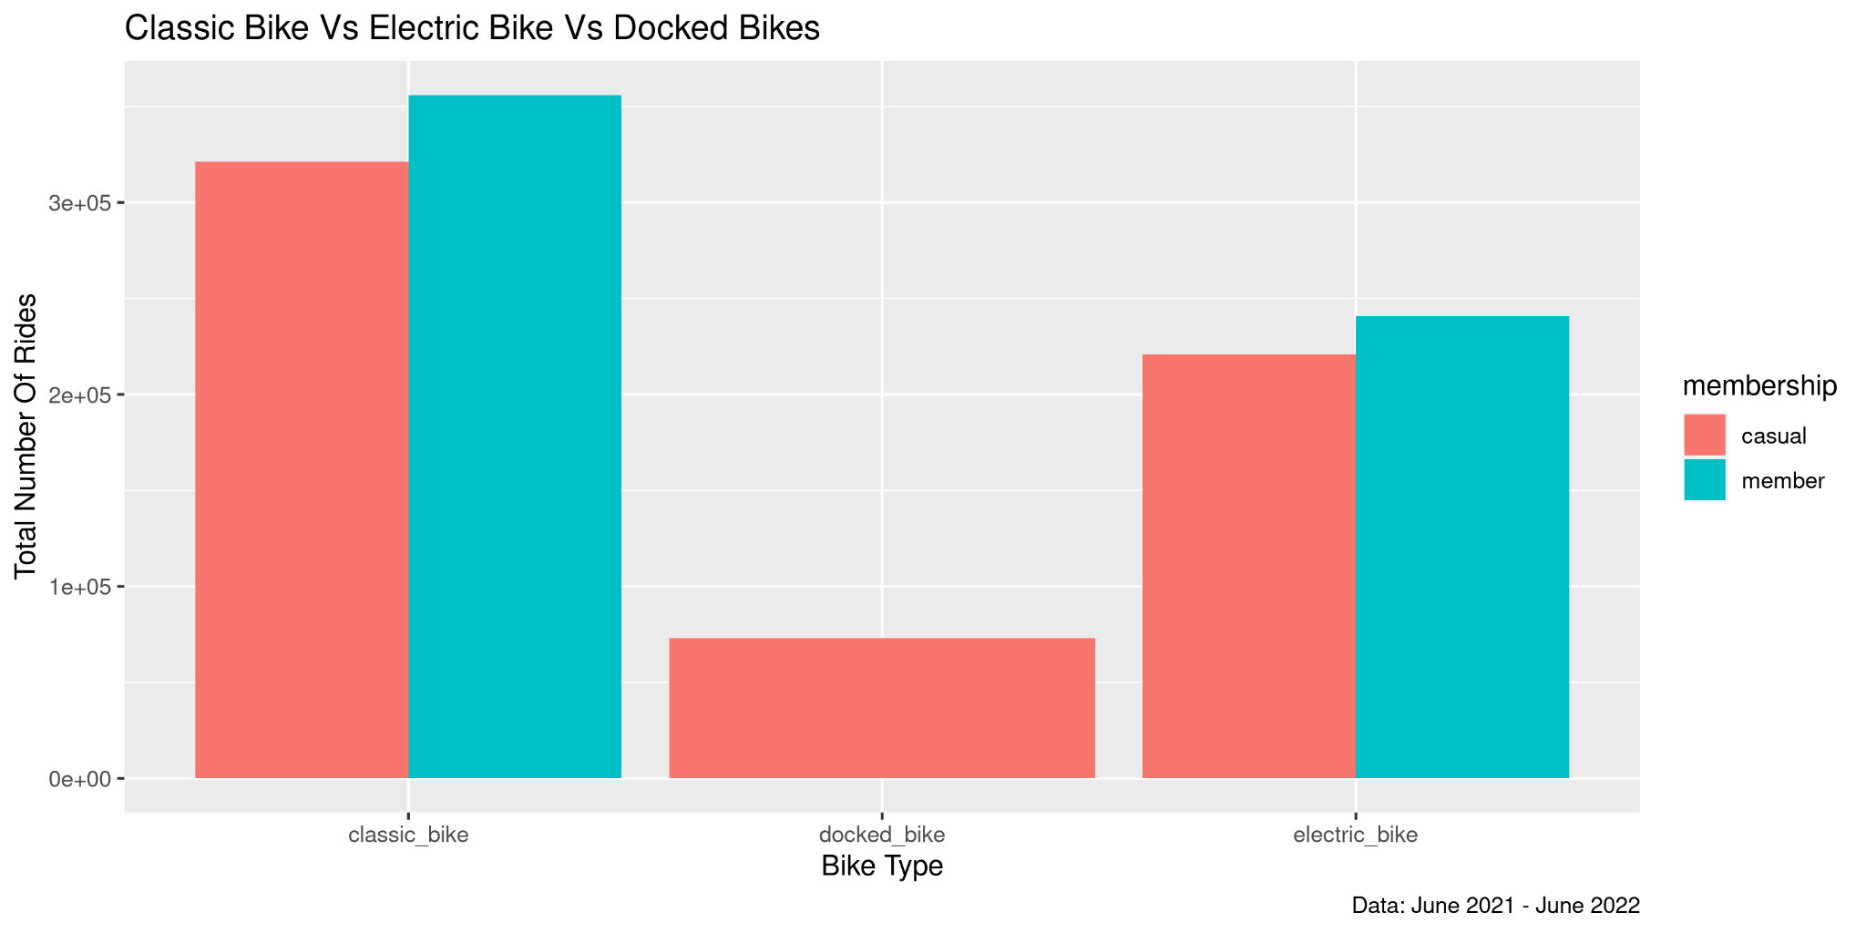
Insights:
Docked bikes are only used by Casual riders.
Docked bikes has the least amount of rides.
Question:
Are docked bikes relevant?
Source: Total number of rides by each bike from June 2021 - June 2022

Slide 6
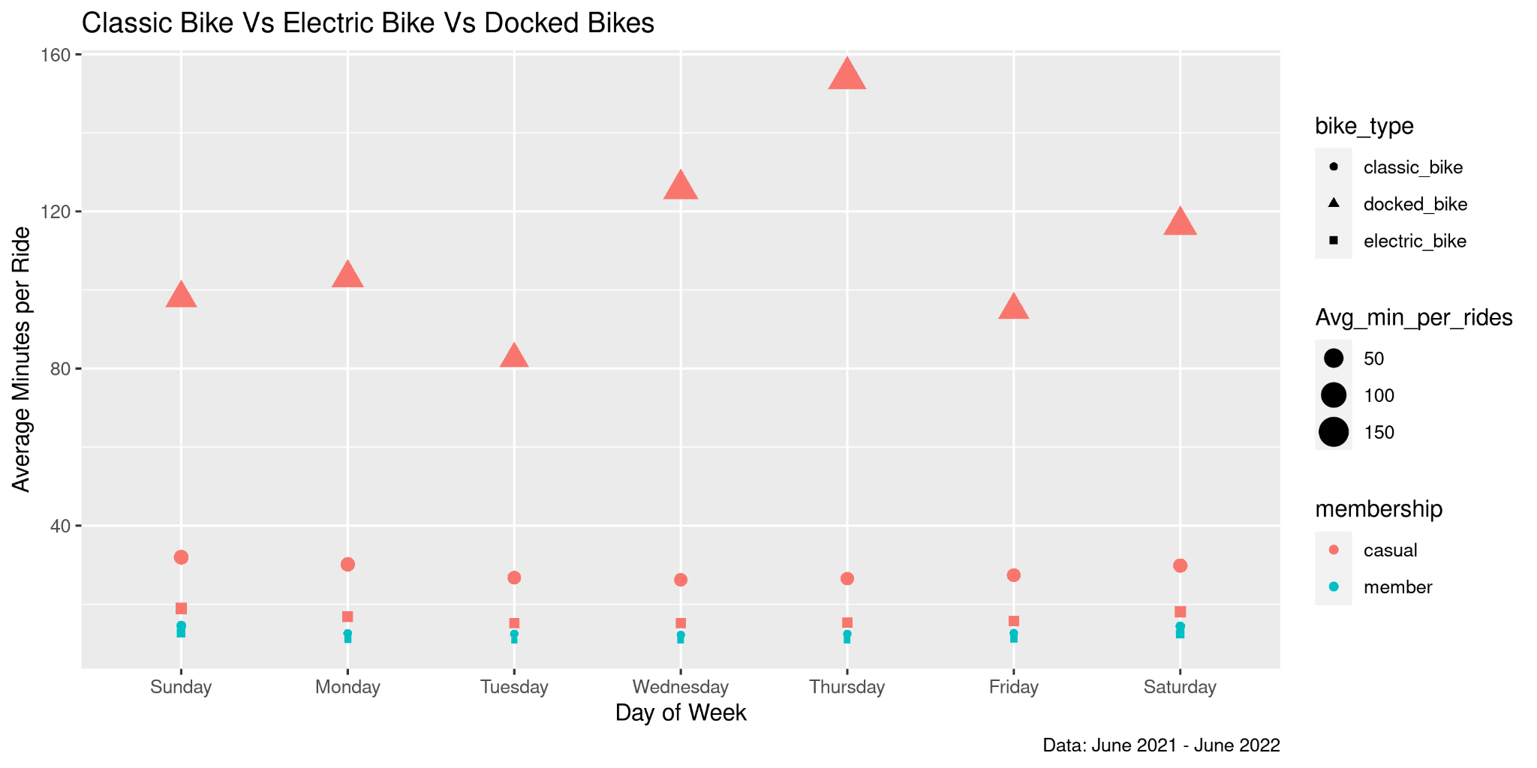
Insights:
Docked bikes have the highest average minutes per ride
Answer:
Yes, Docked bikes are relevant because they are the most enjoyed type of bike.(Average minute per ride = 110 minutes)
Source: Average minutes per ride per day for each membership type from June 2021 - June 2022

Slide 7
But, Docked Bikes do not give us a proper comparison between the two membership types (Casual riders and Annual memberships) as it is only being used by Casual Riders.

Slide 8
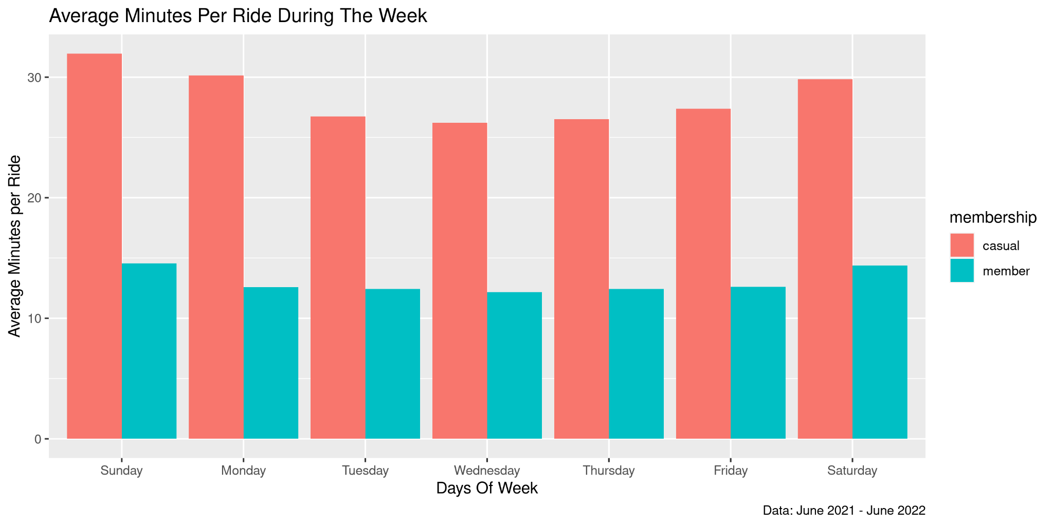
Insights:
Casual riders prefer Classic bikes to Electric bikes.
Source: Average minutes per ride per day for each membership type from June 2021 - June 2022

Slide 9
Identify the differences between casual riders and annual memberships
Analytical Goals
Propose incentives for annual memberships based on the differences

Slide 10
Incentives Proposal
Implement a time-limit on rides for Casual riders and none for Annual membership.
Limited amount of Classic bikes should be made available for Casual riders.
Docked bikes should be exclusive to the Annual membership.

Slide 11
Thank You.

